Slide 1
Django
M – Model
V – View
T – Template

Slide 2
View
Function Based View
Class Based View

Slide 3
Function Based View
A function based view, is a Python function that takes a Web request and returns a Web response.
This response can be the HTML contents of a Web page, or a redirect, or a 404 error, or an XML document, or an image or anything.
Each view function takes an HttpRequest object as its first parameter.
The view returns an HttpResponse object that contains the generated response. Each view function is responsible for returning an HttpResponse object.
We will call these functions as view function or view function of application or view.
Syntax:-
def function_name (request):
return HttpResponse(‘html/variable/text’)
HttpRequest Object
HttpResponse Object
It’s a Class

Slide 4
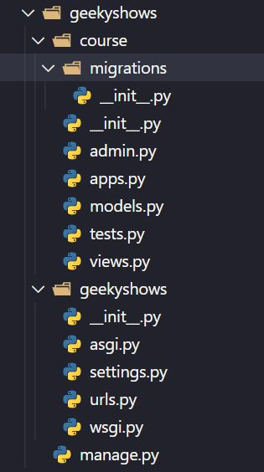
Function Based Views
We use views.py file of the application to write functions which may contain business logic of application, later it required to define url name for this function in the urls.py file of the project.
Syntax:-
views.py
def function_name1 (request):
return HttpResponse(‘html/variable/text’)
def function_name2 (request):
return HttpResponse(‘html/variable/text’)
HttpRequest Object
HttpResponse Object

Slide 5
Function Based Views
Syntax:-
def function_name (request):
return HttpResponse(‘html/variable/text’)
Where HttpResponse is class which is in django.http module so we have to import it before using HttpResponse.
views.py
from django.http import HttpResponse
def learn_django(request):
return HttpResponse(‘Hello Django’)
def learn_python(request):
return HttpResponse(‘<h1>Hello Python</h1>’)
HttpRequest Object
HttpResponse Object
def learn_var(request):
a = ‘<h1>Hello Variable</h1>’
return HttpResponse(a)
def learn_math(request):
a = 10 + 10
return HttpResponse(a)

Slide 6
Function Based Views
Single Application with Single view function
views.py
from django.http import HttpResponse
def learn_django(request):
return HttpResponse(‘Hello Django’)
urls.py
urlpatterns = [
path(‘admin/’, admin.site.urls),
path(‘learndj/’, views.learn_django),
]

Slide 7
Function Based Views
Single Application with multiple view functions.
views.py
from django.http import HttpResponse
def learn_django(request):
return HttpResponse(‘Hello Django’)
def learn_python(request):
return HttpResponse(‘<h1>Hello Python</h1>’)
urls.py
urlpatterns = [
path(‘learndj/’, views.learn_django),
path(‘learnpy/’, views.learn_python),
]

Slide 8
Geeky Steps
Create Django Project: django-admin startproject geekyshows
Change Directory to Django Project: cd geekyshows
Create Django Application: python manage.py startapp course
Add/Install Application to Django Project (course to geekyshows) using settings.py file INSTALLED_APPS = [‘django.contrib.admin’,‘course’, ]
Write View Function inside views.py file
Open views.py
Import HttpResponse class from django.http module
from django.http import HttpResponse
Write view Function
def learn_django(request):
return HttpResponse(‘Hello Django’)
Save views.py

